Slide 1
Anglia Ruskin University
School of Computing and Information Science
Machine Learning in Finance
MOD 009701
Week 3: Machine Learning Pipeline in Finance and Risks
Dr Vitaliy Milke
PhD in Computer Science and Machine Learning
MSc in Computer Science
MSc in Rocket Engineering
vitaliy.milke@aru.ac.uk
vmilke@gmail.com

Slide 2
Machine Learning in Finance
MOD 009701
Disclaimer
Do not play on stock exchanges while studying or for training purposes!

Slide 3

Machine Learning in Finance
MOD 009701
Disclaimer

Slide 4

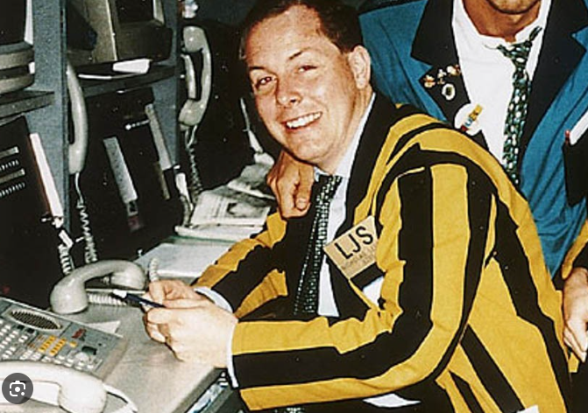

Machine Learning in Finance
MOD 009701
Barings Bank Collapse
Nick Leeson

Slide 5


Machine Learning in Finance
MOD 009701
Barings Bank Collapse

Slide 6
Machine Learning in Finance
MOD 009701
Disclaimer
Do not play on stock exchanges while studying or for training purposes!

Slide 7
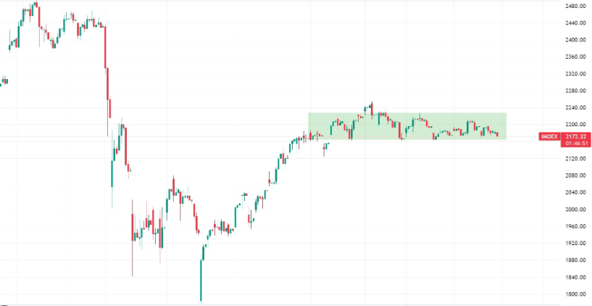
Machine Learning in Finance
MOD 009701
Machine Learning VS.
Financial Market
Typical Machine Learning task in Finance
Up
?
Down

Slide 8
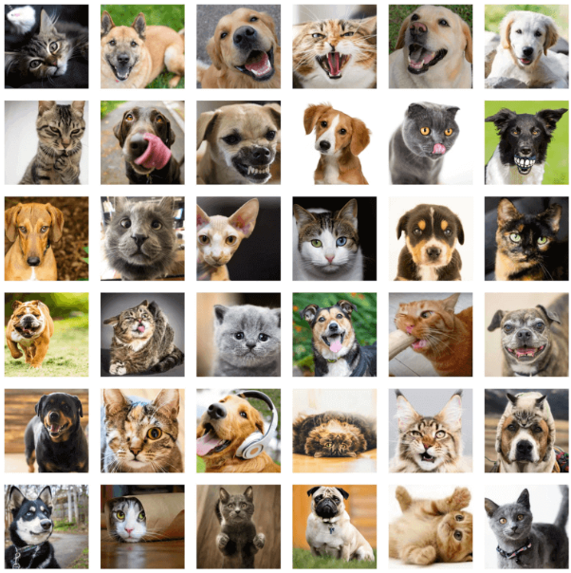
Machine Learning in Finance
MOD 009701
Machine Learning VS.
Financial Market
VS.

Slide 9


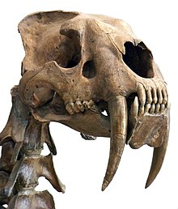
Machine Learning in Finance
MOD 009701
Machine Learning VS.
Financial Market
VS.
Saber-toothed tiger (Smilodon)
Wolf

Slide 10
Machine Learning in Finance
MOD 009701
Machine Learning VS.
Financial Market
patterns of financial market participants’ behaviours are constantly changing.
dogs and cats have been changed significantly from Smilodon’s time
VS.
dogs and cats have mostly stayed the same in 10 years
Time
30,000 year ago, (Smilodon Time)
2015, Revolution in Convolutional Neural Networks
Today

Slide 11
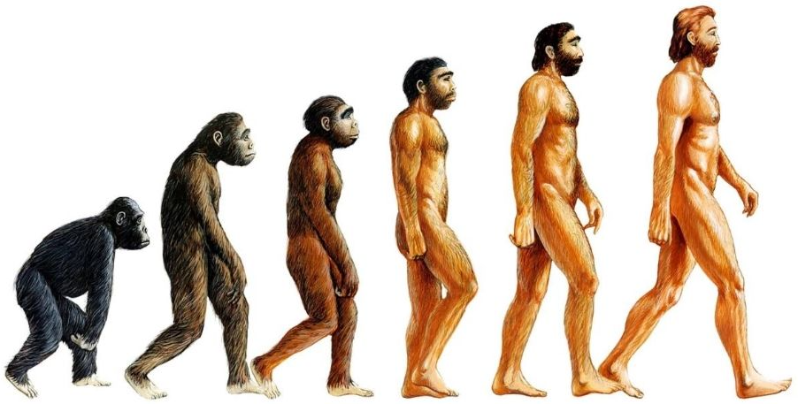
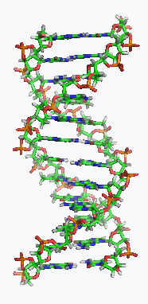

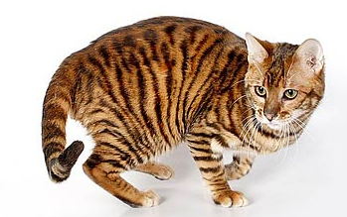
Machine Learning in Finance
MOD 009701
Machine Learning VS.
Financial Market
DNA
~95% of the same DNA
?? % of the same DNA

Slide 12
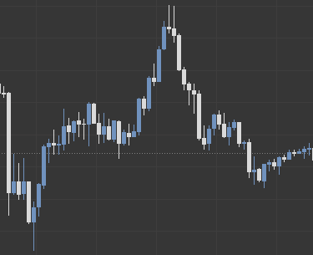
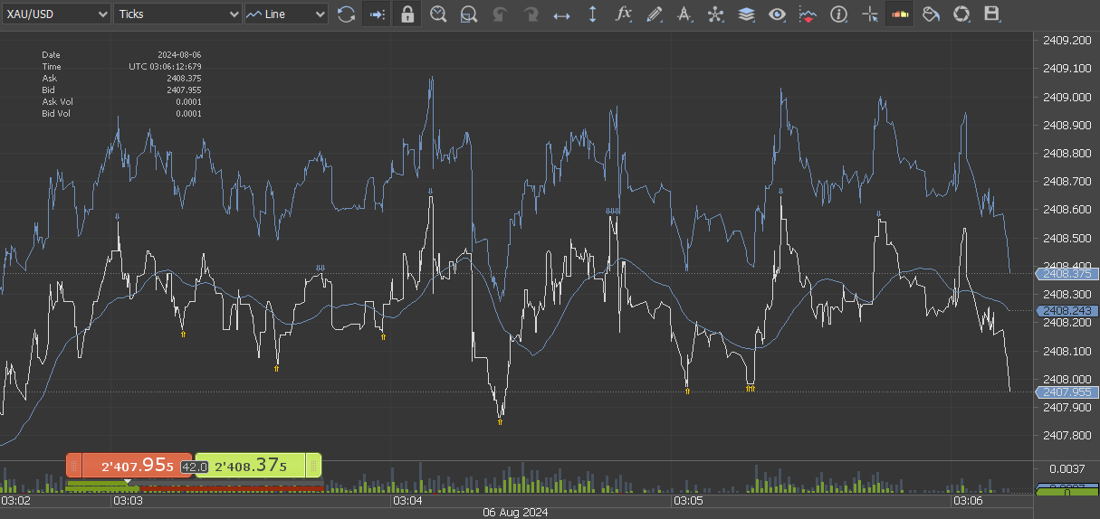
Machine Learning in Finance
MOD 009701
Machine Learning VS.
Financial Market
Long-term
Short-term Tick data

Slide 13
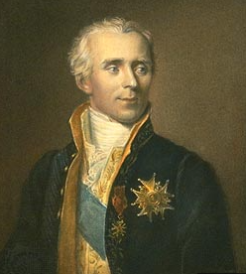

Machine Learning in Finance
MOD 009701
Laplace's demon
Source: - Johnson, T., 2017. The Ascendancy of Financial Economics. In: Ethics in Quantitative Finance (pp. 195-220). Palgrave Macmillan, Cham
- Grünke, P., 2019. Chess, Artificial Intelligence, and Epistemic Opacity. Információs Társadalom, 19, pp.1-7.
- Gruner, S. and Bartelmann, M., 2020. On Computer Simulation, with Particular Regard to their Application in Contemporary Astrophysics.
Cosmos and History: The Journal of Natural and Social Philosophy, 16(2), pp.537-581.

Slide 14
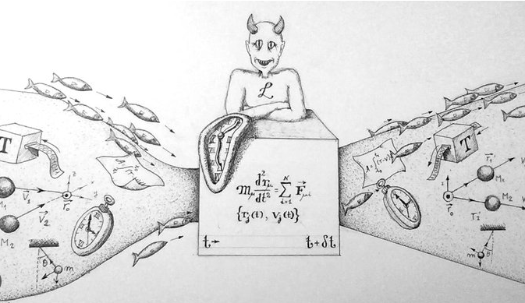
Machine Learning in Finance
MOD 009701
Laplace's demon
A “Laplace's Demon” for the Age of Quantum Uncertainty

Slide 15
Machine Learning in Finance
MOD 009701
Machine Learning Pipeline
Data Preprocessing:
Solve problems with missing values
Encoding categorical variables
Scaling numerical features
Splitting data into training and testing sets
Data Collection
Data Processing

Slide 16
Machine Learning in Finance
MOD 009701
Machine Learning Pipeline
Feature engineering:
Creating new features or
Selecting relevant features from the data
Aim: Improve the model’s predictive power
Data Collection
Data Processing
Feature engineering

Slide 17
Machine Learning in Finance
MOD 009701
Machine Learning Pipeline
Test Data
Data Collection
Data Processing
Feature engineering
Model Selection
Model Training
Model Evaluation

Slide 18
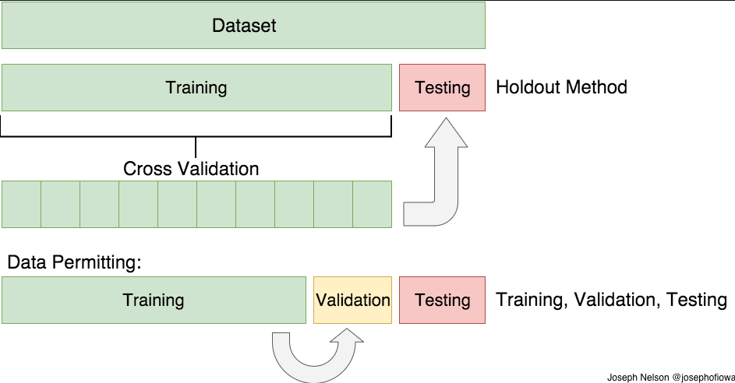
Machine Learning in Finance
MOD 009701
Training, Validation and Testing
cvcsource
Source: https://towardsdatascience.com/train-test-split-and-cross-validation-in-python-80b61beca4b6

Slide 19
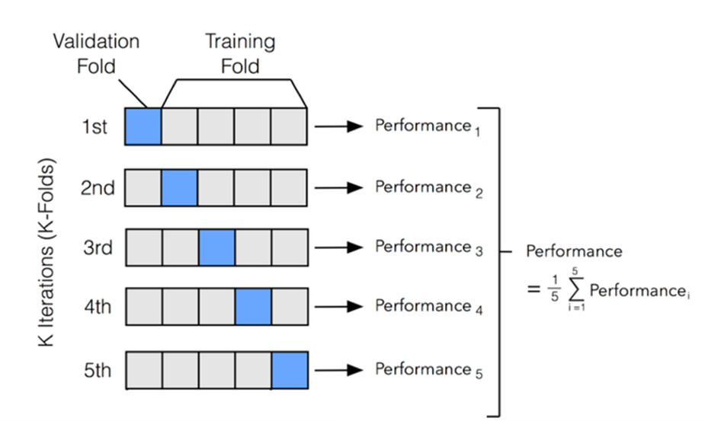
Machine Learning in Finance
MOD 009701
Cross Validation

Slide 20
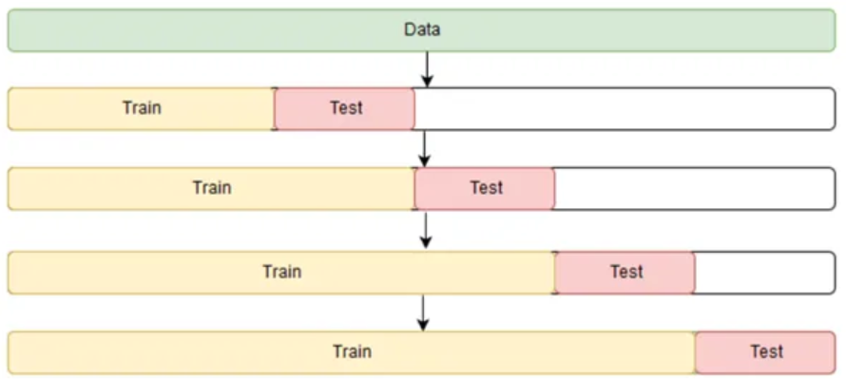
Machine Learning in Finance
MOD 009701
Cross-Valisation on Time-Series

Slide 21
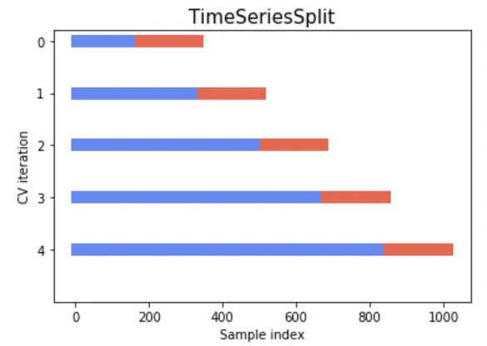
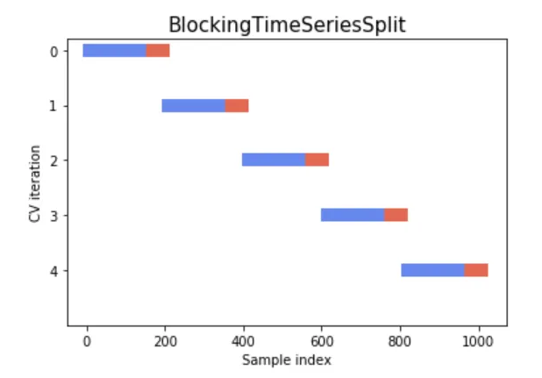
Machine Learning in Finance
MOD 009701
Cross-Valisation on Time-Series

Slide 22
Machine Learning in Finance
MOD 009701
Machine Learning Pipeline
…in Finance
Test Data
Data Collection
Data Processing
Feature engineering
Model Selection
Model Training
Model Evaluation
Model Modification
Model Optimisation
Model Deployment

Slide 23
Machine Learning in Finance
MOD 009701
Machine Learning Pipeline
…in Finance
Test Data
Data Collection
Data Processing
Feature engineering
Model Selection
Model Training
Model Evaluation
Model Modification
Model Optimisation
Live Trading
in real time
(by 1 share/ 1 contract)
Paper Trading
Historical Data Testing (Backtesting)
Model Deployment

Slide 24
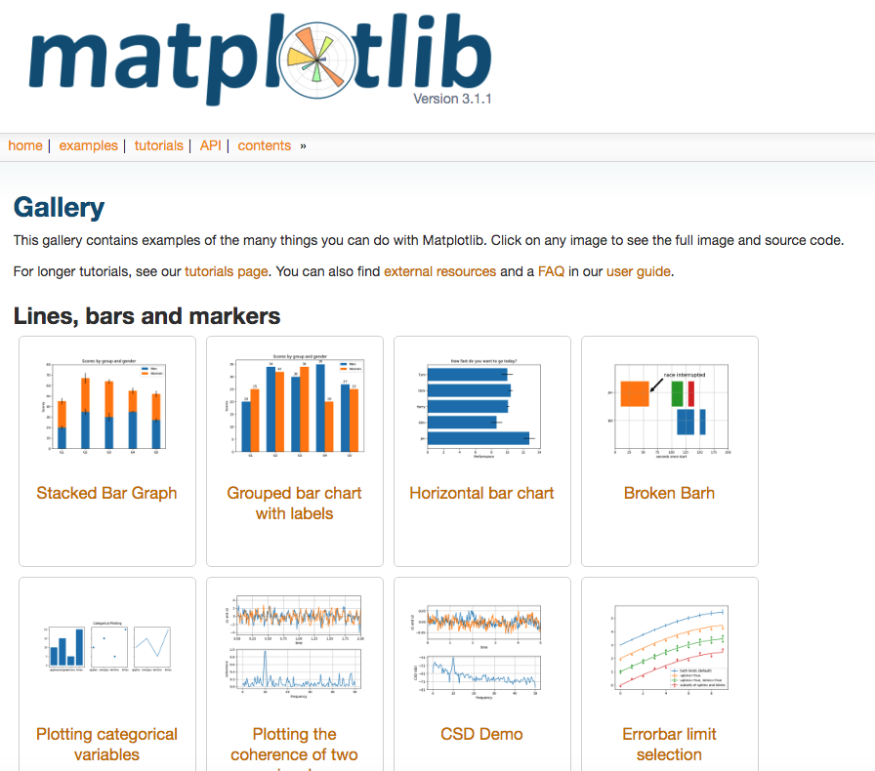
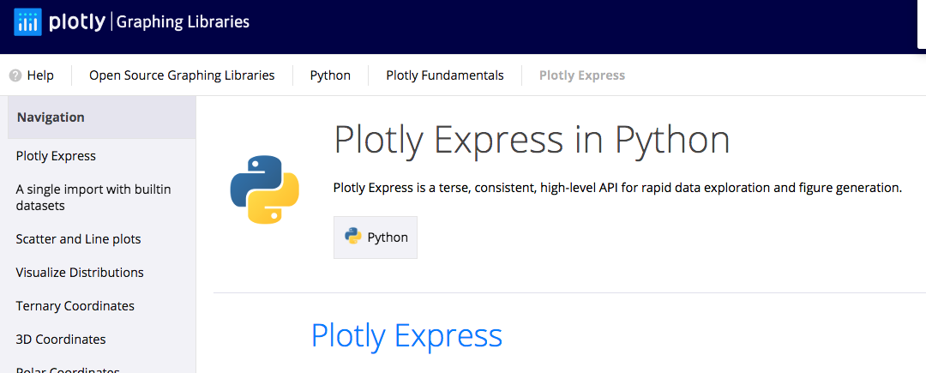
Machine Learning in Finance
MOD 009701
Matplotlib and Plotly Express
Plotly Express
Source:
https://matplotlib.org/
http://python-graph-gallery.com/boxplot/
https://flowingdata.com/
https://plot.ly/python/time-series/

Slide 25
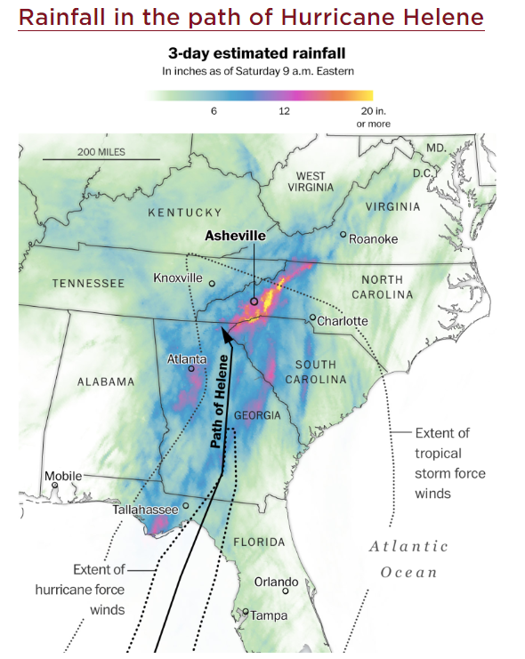
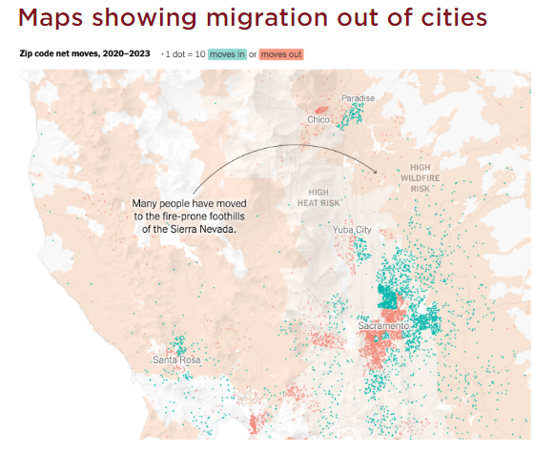
Machine Learning in Finance
MOD 009701
Data Visualisation on Maps
Source:
https://flowingdata.com/

Slide 26
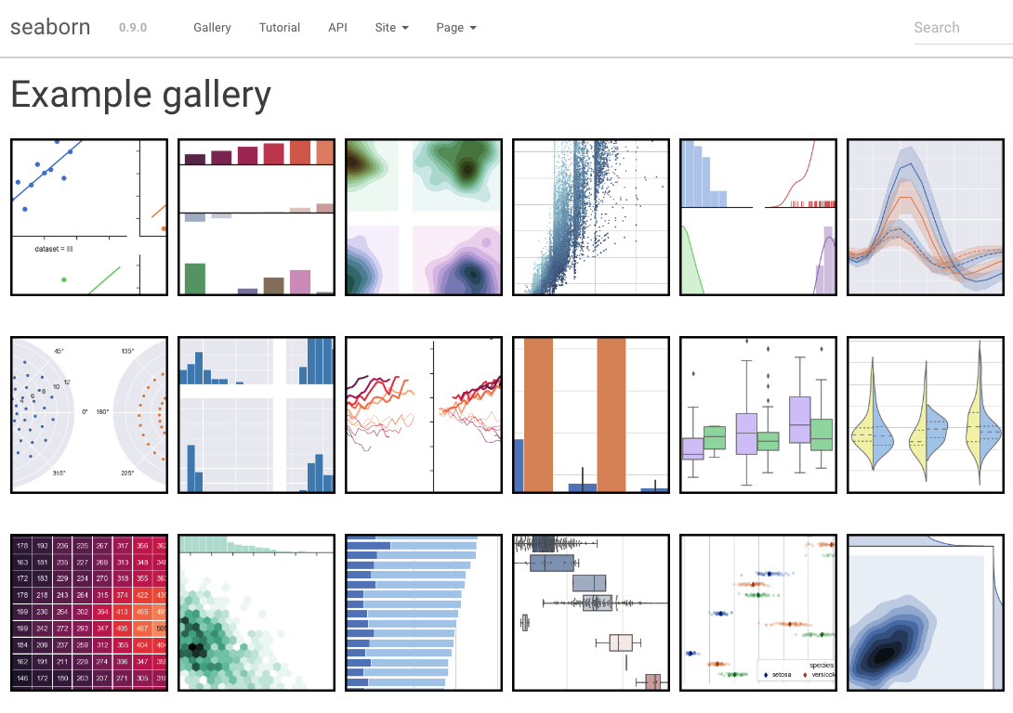
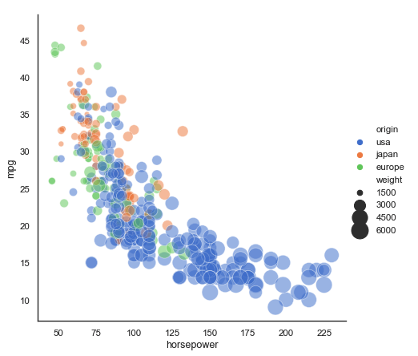
Machine Learning in Finance
MOD 009701
Seaborn
Seaborn is a Python data visualization library based on Matplotlib
Source:
https://seaborn.pydata.org/index.html

Slide 27
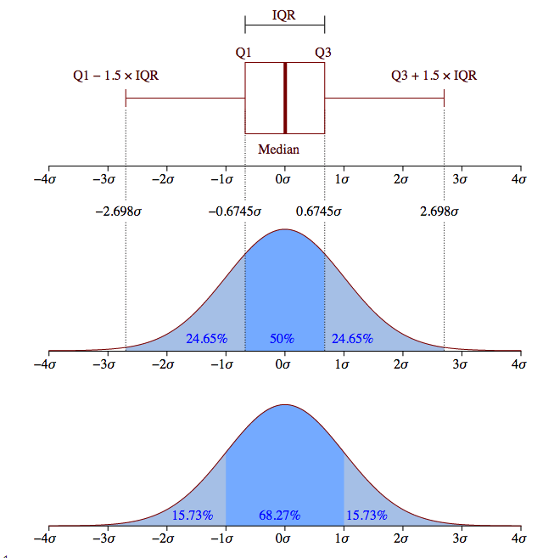
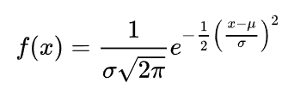
Machine Learning in Finance
MOD 009701
Normal (Gaussian) distribution and
BoxPlot diagram

Slide 28
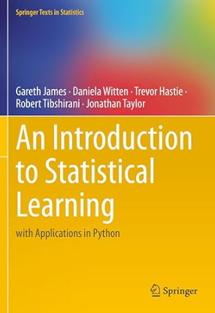
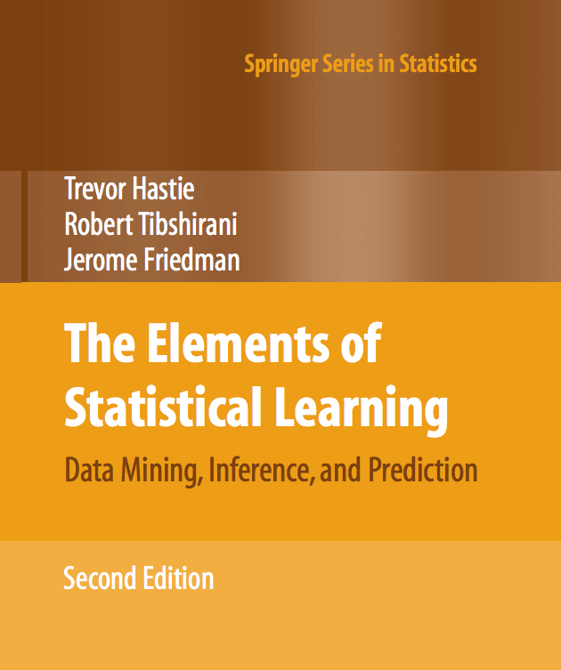
Machine Learning in Finance
MOD 009701
Statistical Learning

Slide 29
Machine Learning in Finance
MOD 009701
Normal (Gaussian) distribution and
BoxPlot diagram

Slide 30
Machine Learning in Finance
MOD 009701
Normal (Gaussian) distribution and
BoxPlot diagram

Slide 31
Machine Learning in Finance
MOD 009701
Normal (Gaussian) distribution and
BoxPlot diagram

Slide 32
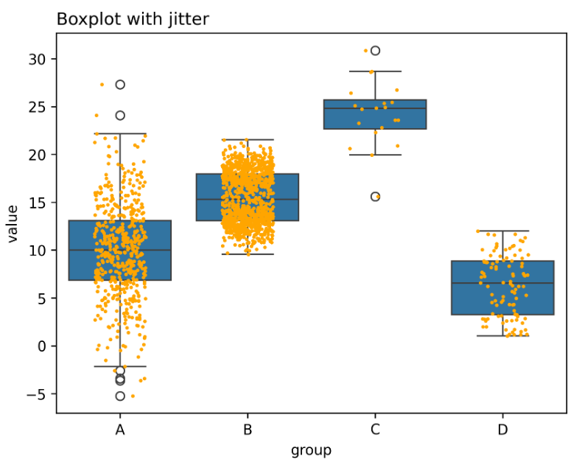
Machine Learning in Finance
MOD 009701
BoxPlot diagram

Slide 33
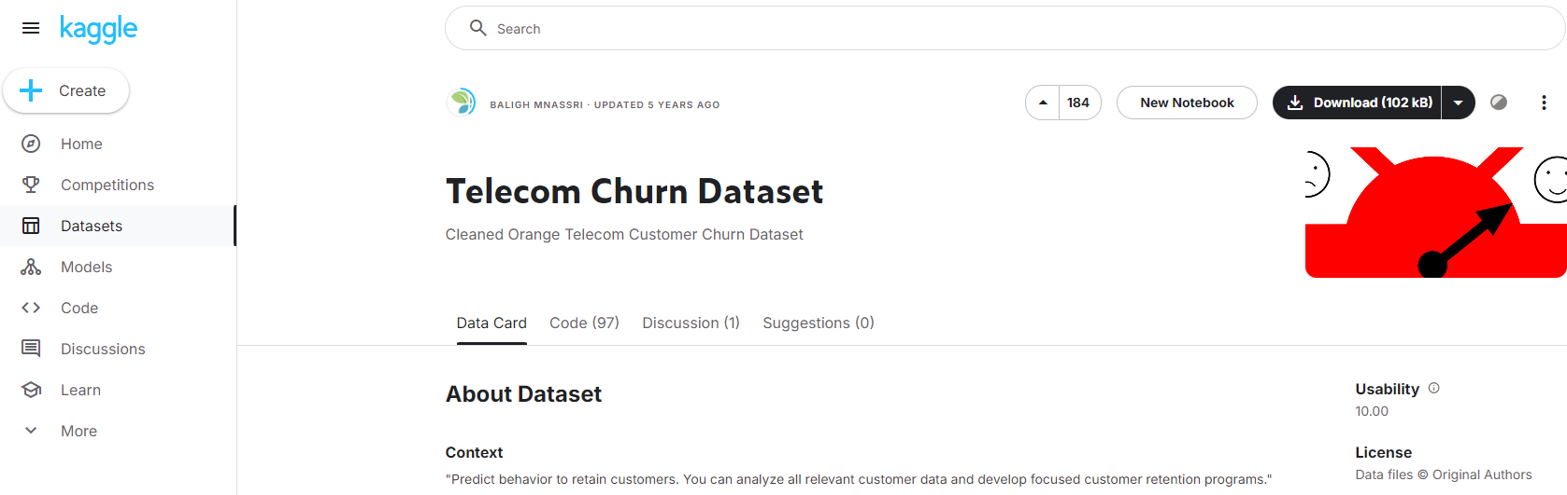

Machine Learning in Finance
MOD 009701
Customer Churn
Source:
https://www.kaggle.com/datasets/mnassrib/telecom-churn-datasets

